Slide 1
Trust… but verify!
Lecture 5
On the importance of experimental data curation

Slide 2


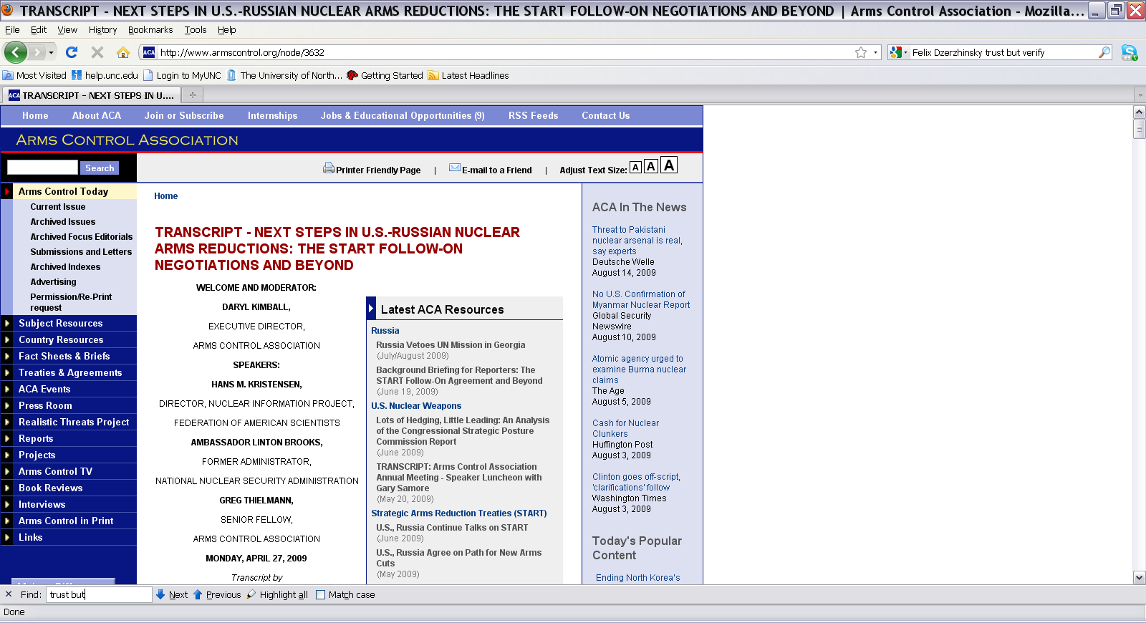
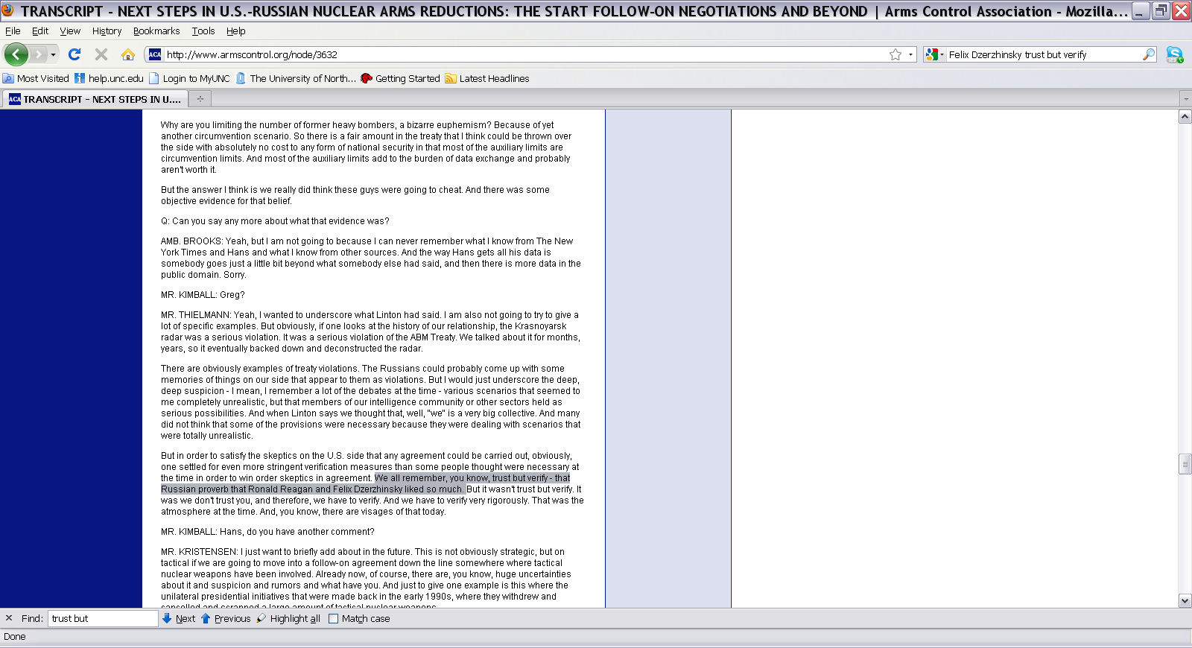
The importance of data curation:
What do these two men have in common?.

Slide 3
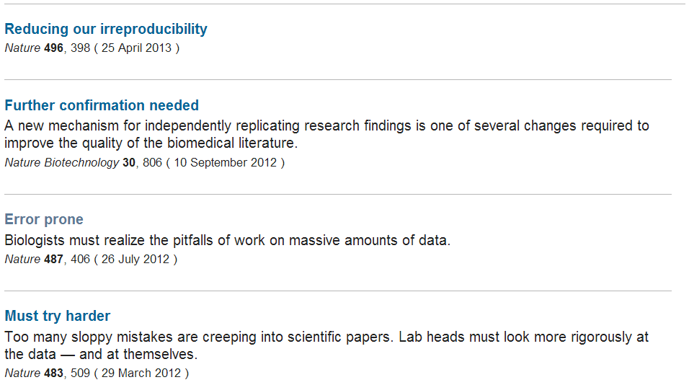
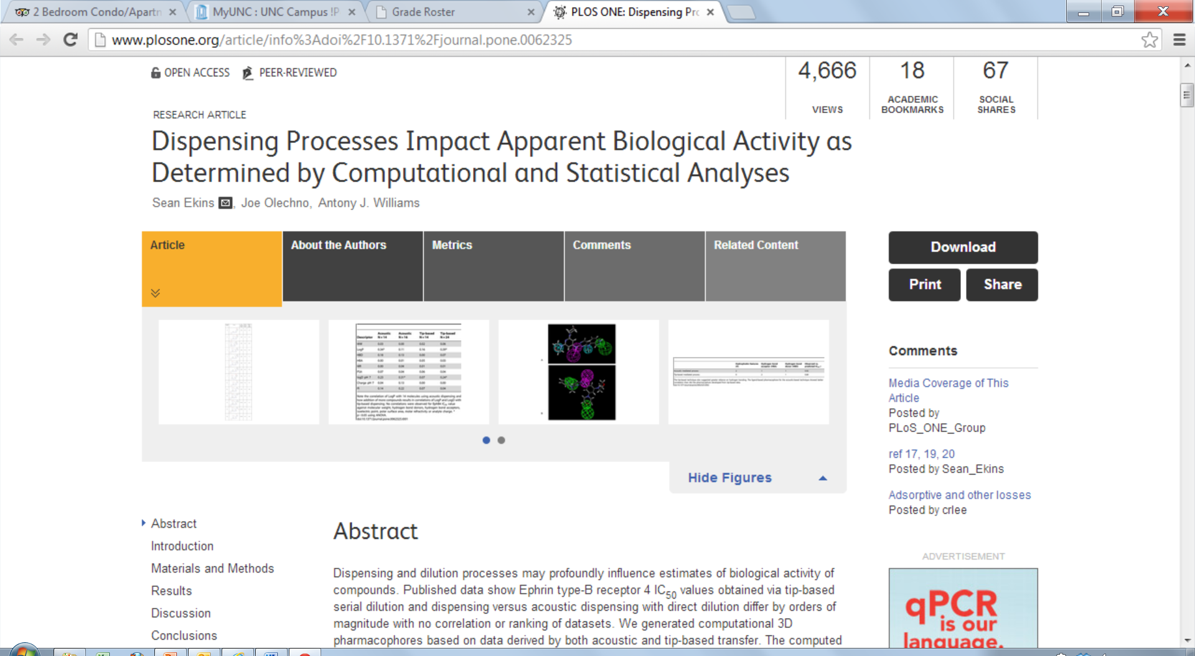
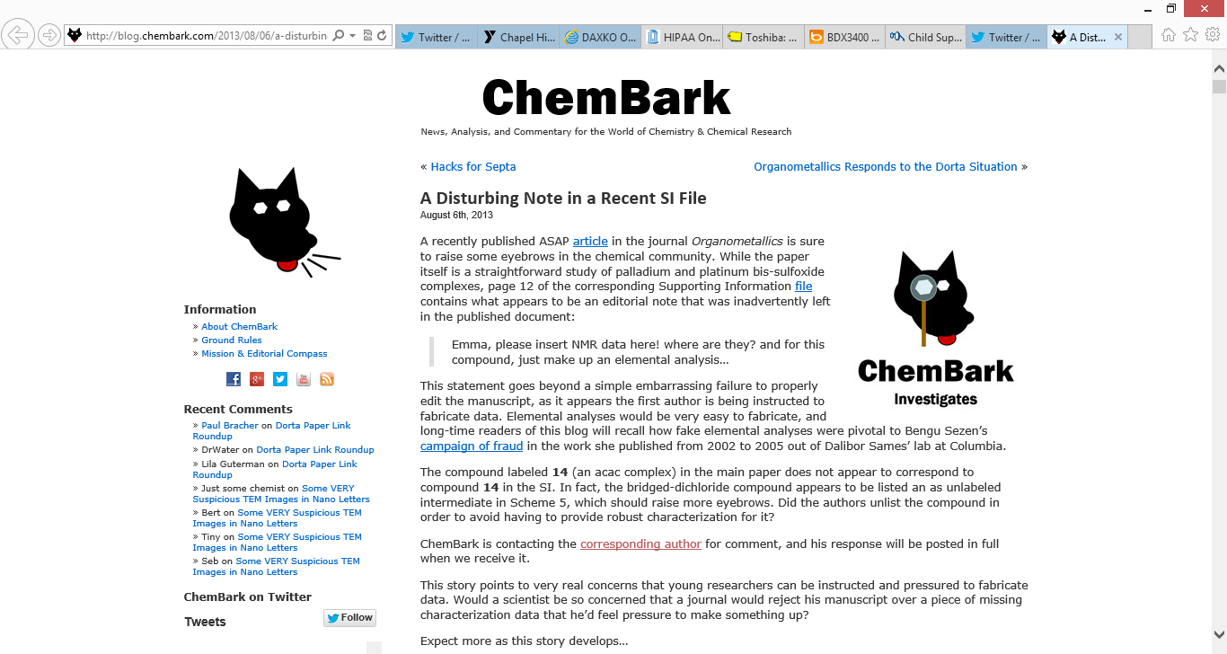
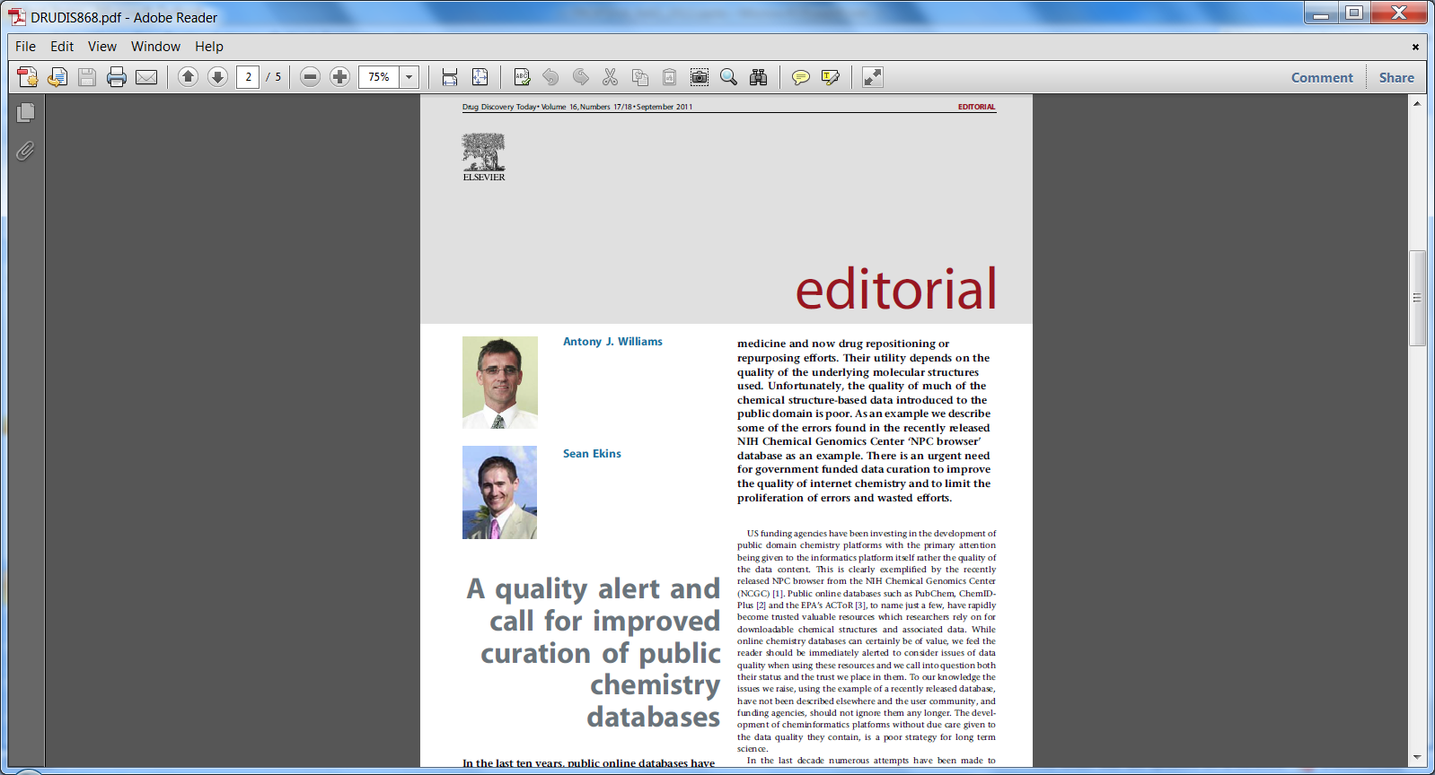
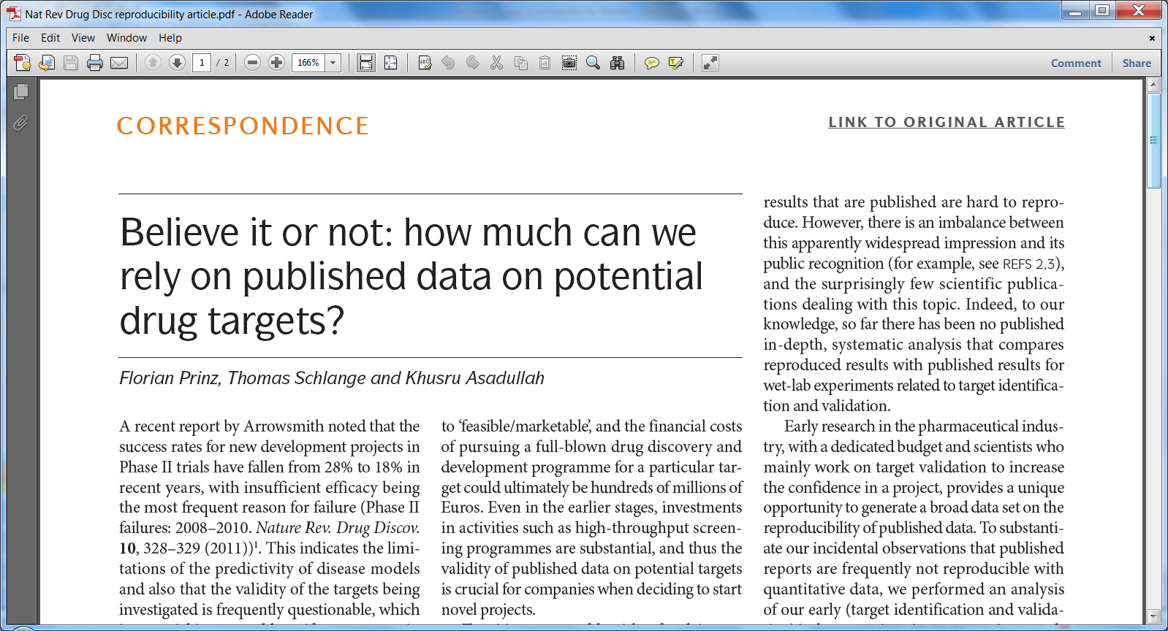

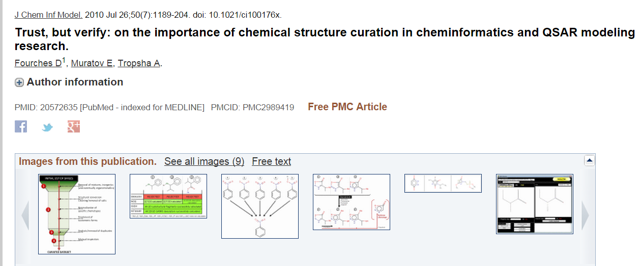
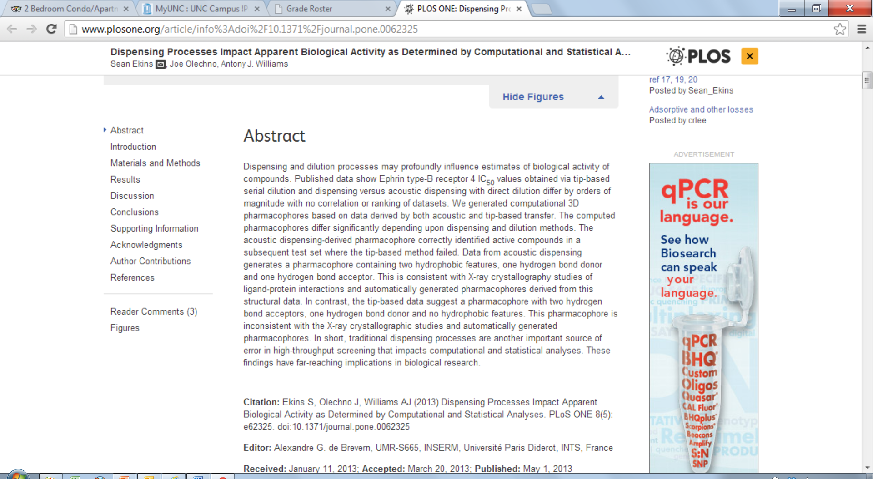
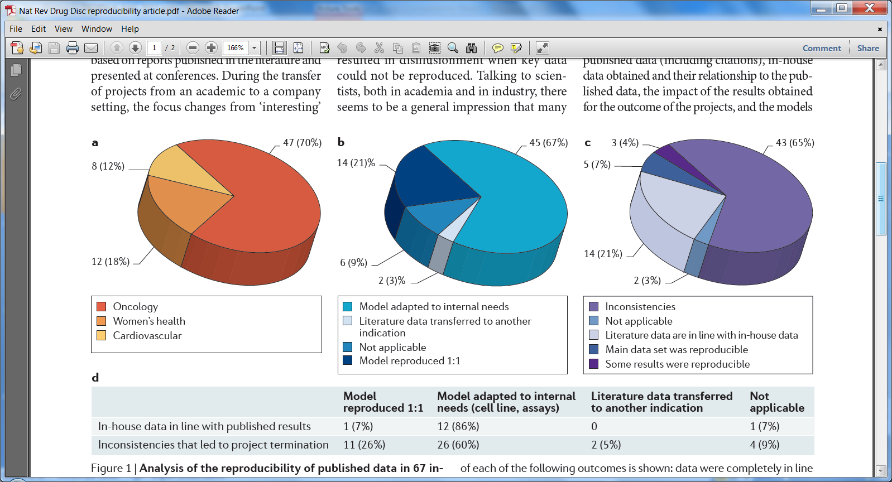
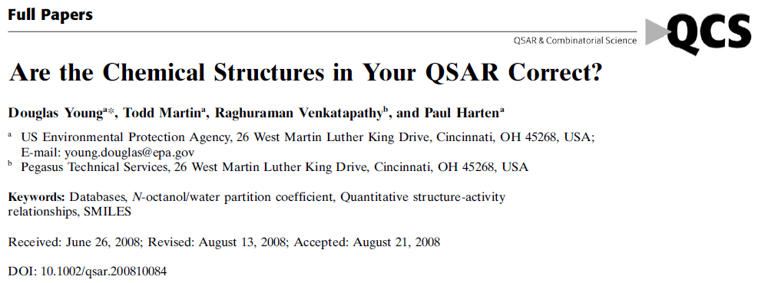
Data curation is critical to achieve high quality
databases and enable modeling studies
Florian Prinz, Thomas Schlange and Khusru Asadullah. Nature Rev. Drug Disc. Sep 2011
3
Notes:
3

Slide 4
Data dependency and data quality are critical issues in QSAR
Cheminformaticians are at the mercy of data providers. Prediction performance of (Q)SAR models could depend strongly on the quality of input data (both structures and activities).
Both chemical and biological data in a dataset may be inaccurate and in need of thorough curation
The number of published QSAR models that were poor or not too successful due to data quality issue is unknown but possibly large
Often considered trivial, the basic steps to curate a dataset of compounds are not so obvious especially for beginners.
4

Slide 5
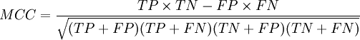
Experimental data quality: Comparison of the ToxCAST (Phase I) in vitro Assay Results for Duplicates
Compounds | Total | ACEA | ATG | BSK | Cellumen | NVS | CellzDirect
 | 500 | 7 | 81 | 87 | 33 | 239 | 48
3-Iodo-2-propynylbutylcarbamate | 0.71 | 0.73 | 0.18 | 0.53 | 0.49 | 0.89 | 0.15
Bensulide | 0.64 | 0.09 | 0.71 | 0.4 | 0.69 | 0.95 | 0.04
Chlorsulfuron | 0.24 | N/A | N/A | 0.4 | N/A | N/A | -0.1
Dibutyl phthalate | 0.55 | N/A | 0.62 | 0.51 | 0.7 | 0.81 | -0.1
Diclofop-methyl | 0.36 | 1 | 0.89 | 0.15 | N/A | -0 | -0.1
EPTC | 0.13 | N/A | N/A | -0.1 | N/A | N/A | 0.33
Fenoxaprop-ethyl | 0.47 | N/A | 0.56 | 0.59 | 0.31 | 0.35 | 0.01
Prosulfuron | 0.55 | N/A | 0.68 | 0.08 | N/A | 1 | 0.4
*
5

Slide 6
QSAR modeling with non-curated datasets
Presence of ERRONEOUS OR
WRONG STRUCTURES
0.613
0.380
-0.222
7.08
1.146
0.491
0.301
0.141
0.956
0.256
0.799
1.195
1.005
Presence of MISPRINTS
AND WRONG NAMES
D
E
S
C
R
I
P
T
O
R
S
ERRORS in the calculation
of DESCRIPTORS
QSAR MODELS ???
Presence of DUPLICATES
Presence of MIXTURES
Presence of SALTS
Etc.

Slide 7
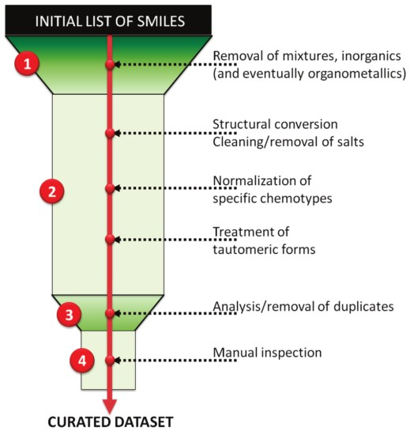
Chemical Structure Curation
Chemical structures should be cleaned and standardized (duplicates removed, salts stripped, neutral form, canonical tautomer, etc) to enable rigorous model development)
Quinine sulfate dihydrate
Pyridostigmine Bromide
Fenoprofen Sodium
Muratov, Fourches, Tropsha. Trust but verify. JC J. Chem. Inf. Model. 2010, 50, 1189-1204.
7

Slide 8
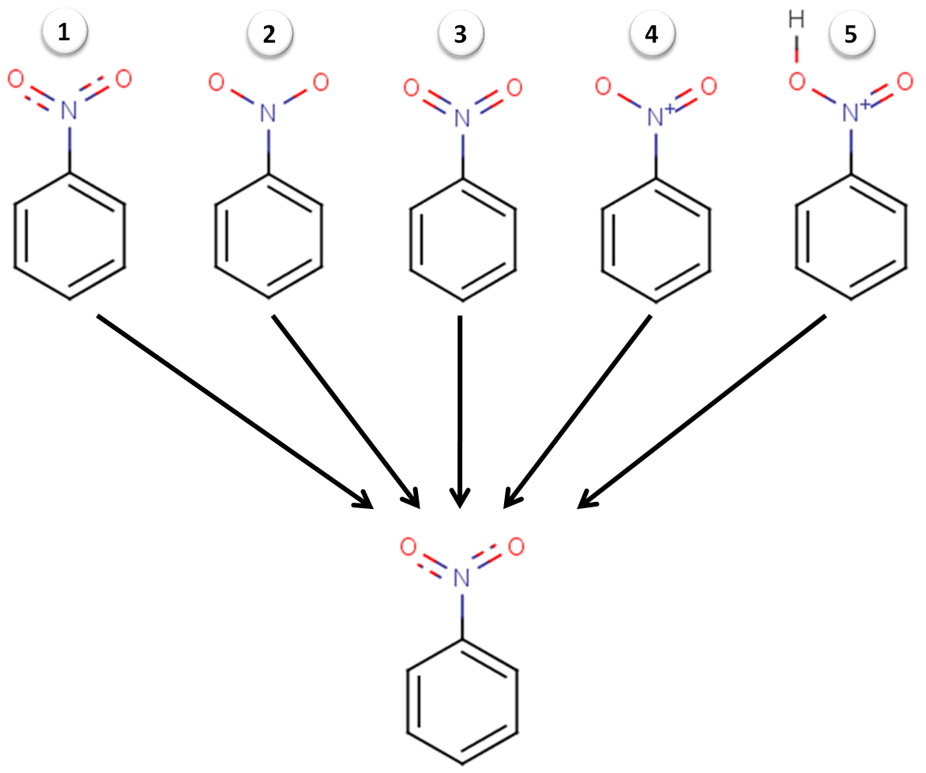
QSAR modeling of nitro-aromatic toxicants
-Case Study 1: 28 compounds tested in rats, log(LD50), mmol/kg.
Case Study 2: 95 compounds tested against Tetrahymena pyriformis, log(IGC50), mmol/ml.
Five different legitimate representations
of nitro groups.
.
Case Study 1: after the normalization of nitro groups R²_{ext}~0.45 increased to R²_{ext}~0.9.
Data curation affects the accuracy
(up or down!) of QSAR models
Case Study 2: after the normalization of nitro groups R²_{ext}~0 increased to R²_{ext}~0.5
Even small differences in structure representation can lead to significant errors in prediction accuracy of models
Artemenko, Muratov et al. SAR QSAR 2011, 22 (5-6), 1-27.
8
Notes:
Two datasets of nitro-aromatic compounds compiled from different sources to investigate the relationships between their chemical structure and toxicity.
8

Slide 9
Looking for biological data errors/uncertainties in databases
What kind of errors do we see?
When replicate values (of target, ligand, and activity type) appear in the literature, how much do they differ by?
Does wrong information arise in the laboratory or does it creep in during publication?
9

Slide 10
ChEMBL Statistics
Used ChEMBL 14 – released 18 July 2012
1,384,479 compound records
1,213,242 distinct compounds
644,734 assays
10,129,256 bioactivities
9,003 targets
46,133 documents
Primarily covers MedChem Literature
Adds annotations for target data
Successor to SARLite commercial database
10

Slide 11
Manual Curation (following several automated steps)
Input: 190,068 compound-target measures in pairs of papers
Used values as published in ChEMBL
Converted to standardized pK_{i} values
Semi-automated (based on units and type of value reported)
23,956 failed to be automatically converted
Mostly Log K_{i} or –Log K_{i} values but others
Manually examined papers representing ~70% and hand converted affinity value, except when data was being recycled/recited
Final: 178,317 total replicate pairs of values
11

Slide 12
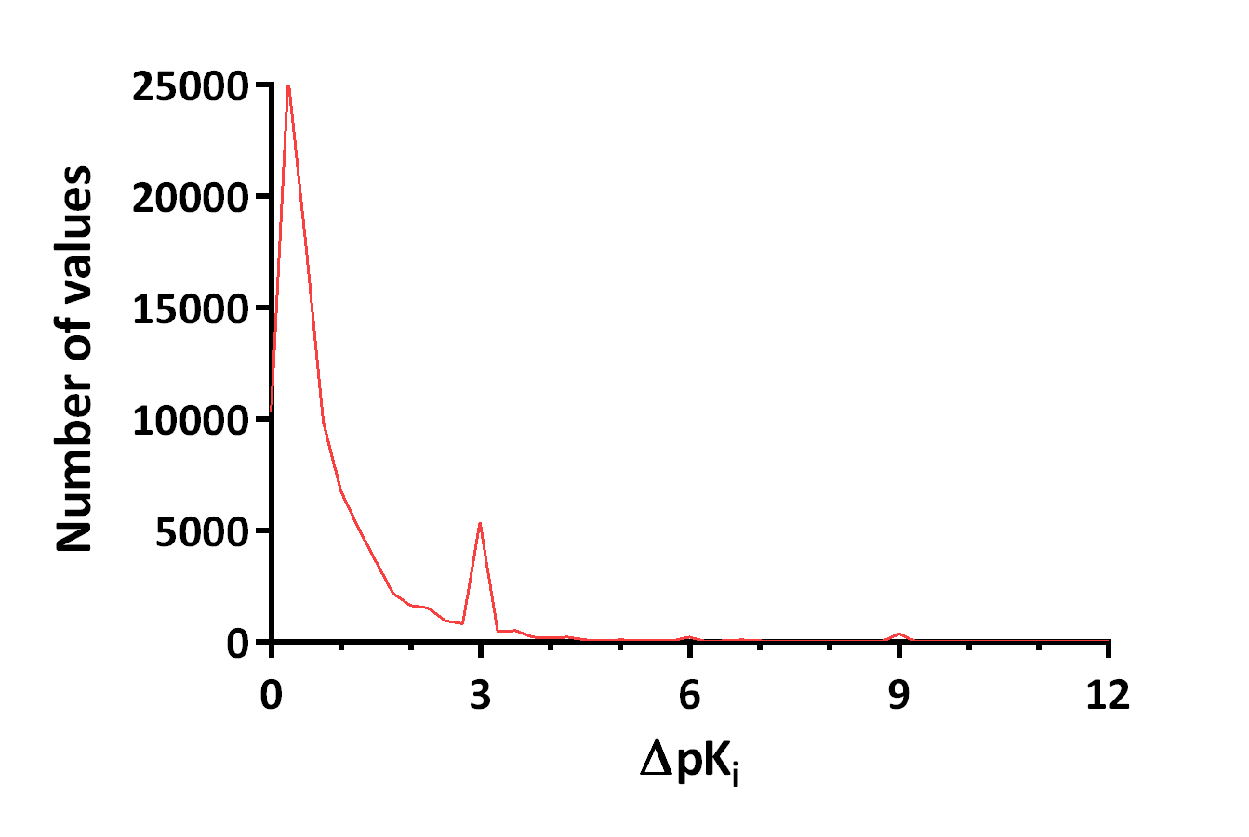
Only Replicates > 1% difference
12

Slide 13
A Recurrent Pattern
Note the peaks at integral pKi differences
13

Slide 14
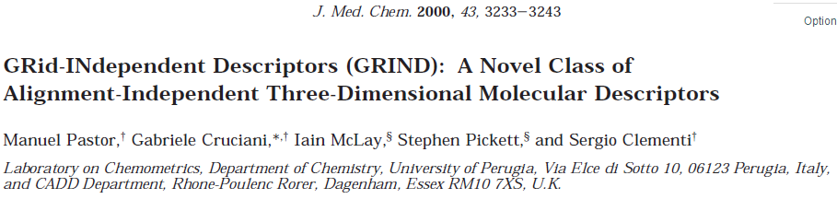
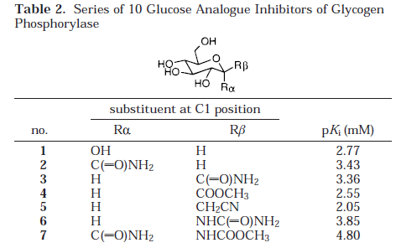
Non-standard Units Used
14

Slide 15
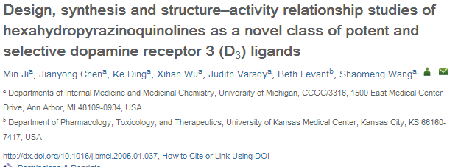
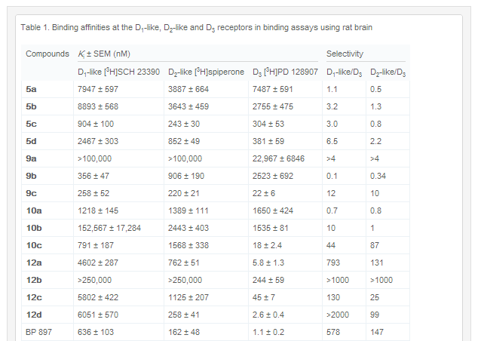
Non-Ki measures given as Ki
These numbers made it into ChEMBL, too.
15

Slide 16
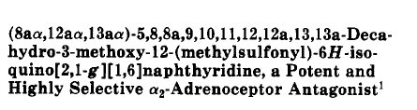
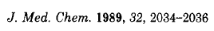
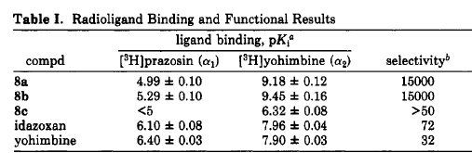
Ignorance of Biological Complexicty
α₂a? α₂b? α₂c?
Target | Doc_ID | Src_Key | Assay_ID | Activity_ID | Std_Type | Std_Value
α₂a | 10218 | 8b | 32635 | 359172 | pK_{i} | 9.45
α₂b | 10218 | 8b | 32635 | 359172 | pK_{i} | 9.45
α₂c | 10218 | 8b | 32635 | 359172 | pK_{i} | 9.45
16

Slide 17
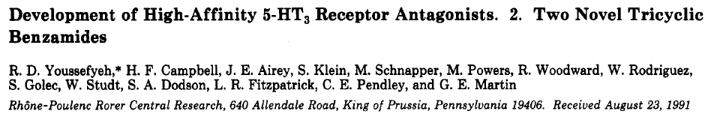
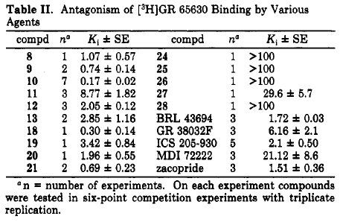
No Units at All
17

Slide 18
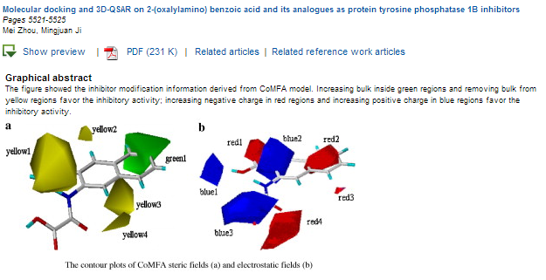
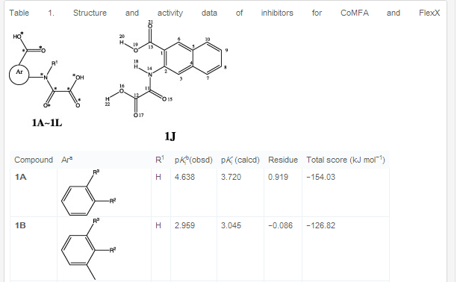
No Citation For Data Sources
18

Slide 19
Summary of published data quality analysis
A lot of the replicates in the literature aren’t actually independent determinations
Many errors come from careless specification or interconversion of units
91% of the data are single reported measurements
Modeling studies often are not explicitly identified as such
ChEMBL 15 and going forward have started to address these issues
This observations suggest new challenges to employ cheminformatics approaches for biological data curation
19

Slide 20
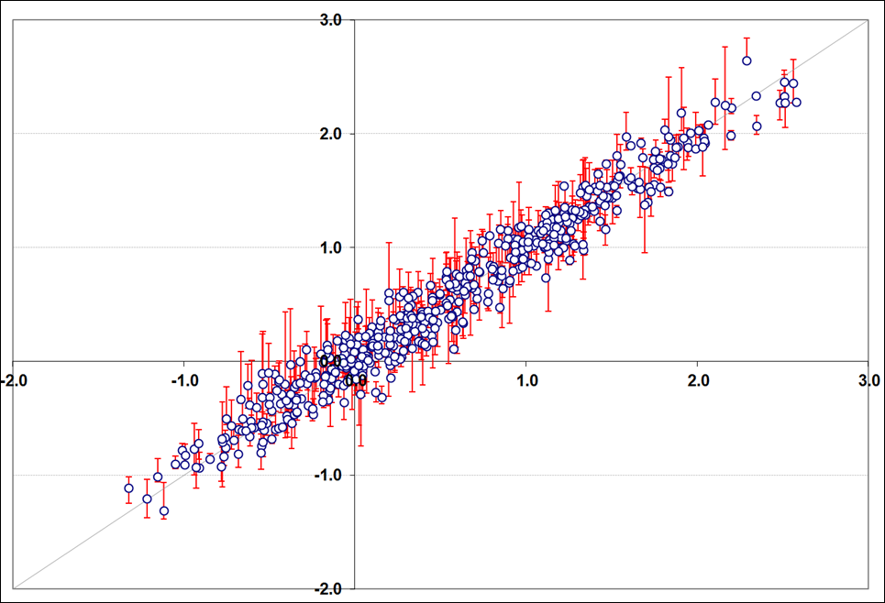
ChEMBL Statistics: experimental uncertainty
Consensus QSAR models predict molecular activities with a compound-specific uncertainty.
However, typically, we tend to ignore the experimental uncertainty/variability associated with each compound.
20

Slide 21
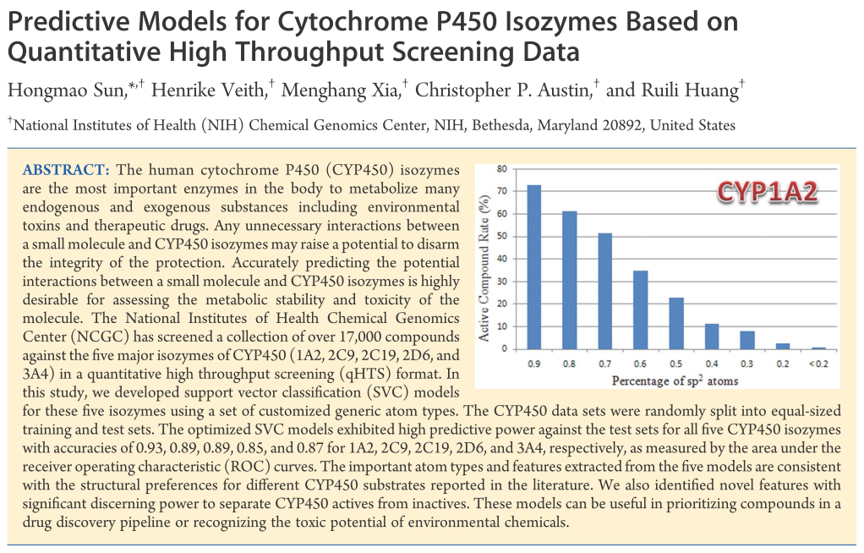
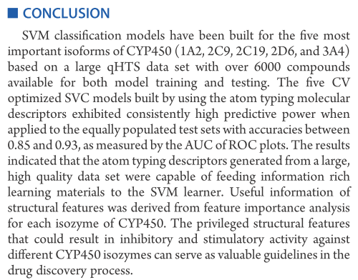
Analysis of one publication: CYP data
J. Chem. Inf. Model. 2011, 51, 2474–2481
21

Slide 22
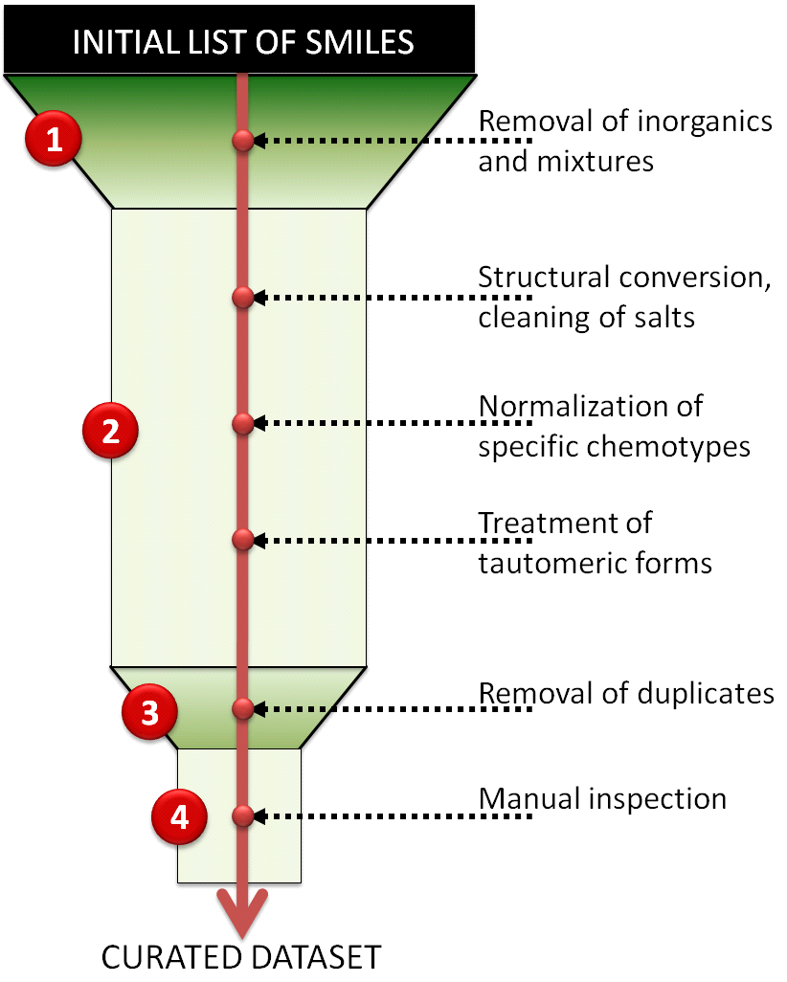
Dataset Curation summary
17143 compounds
17121 compounds
17121 compounds
17121 compounds
17121 compounds
16142 compounds
16142 compounds
Fourches D, et al. J Chem Inf Model. 2010 50(7):1189-204.
22

Slide 23
NCGC dataset analysis of duplicates
Out of 1280 duplicate couples :
406 had no discrepancies-no values or no values for comparison
874 had biological profile differences
A total of 1535 discrepancies were found in the 874 couples of duplicates:
CYP2C19 | CYP2D6 | CYP3A4 | CYP1A2 | CYP2C9
170 | 422 | 426 | 363 | 154 | # of discrepancies
23

Slide 24
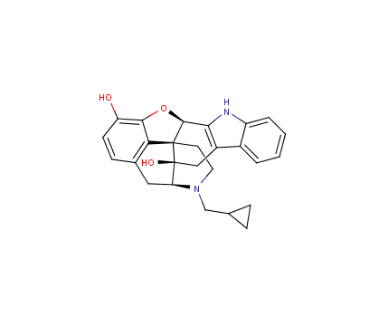
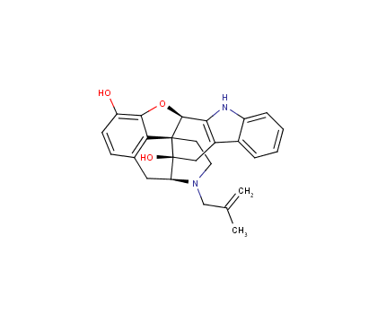
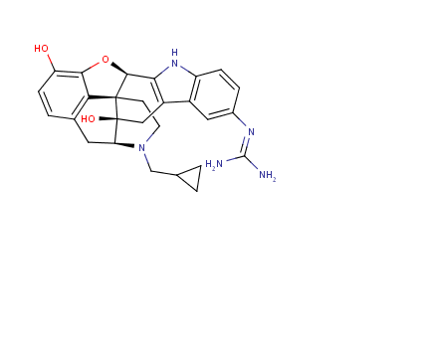
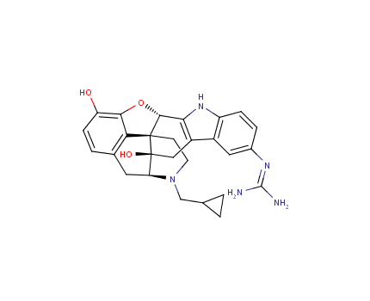
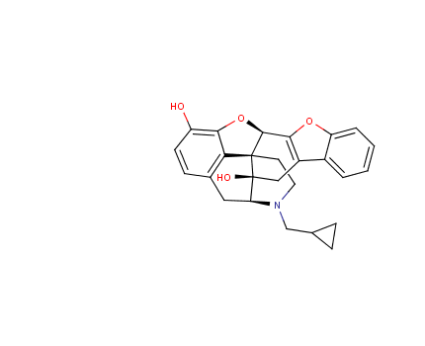
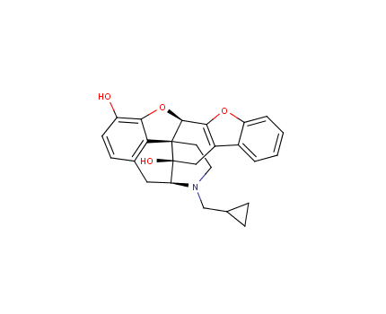
Neighborhood Analysis for Duplicates
17,000 compounds screened against five major CYP450 isozymes.
1,280 pairs of duplicates couples were found (874 had different bioprofiles)
2C19 | 2D6 | 3A4 | 1A2 | 2C9 | Supplier | SID | Tocris-0740
-4.5 | -6.2 | -4.6 | -4.4 | -4.6 | Tocris | 11113673 | CID_6603937
-5 | -5.6 | -8 |  | -4.4 | Sigma Aldrich | 11111504 | CID_6603937
2C19 | 2D6 | 3A4 | 1A2 | 2C9 | Supplier | SID | Tanimoto Similarity | 5 Nearest neighbors
5.5- |  | 4.5- |  |  | Tocris | 11114071 | 0.98 | 6604862
 |  | 5.1- |  |  | Sigma Aldrich | 11112029 | 0.98 | 6604106
 |  |  |  |  | Tocris | 11114012 | 0.98 | 6604846
 | 5.9- | 4.8- |  |  | Sigma Aldrich | 11112054 | 0.95 | 6604136
 | 4.5- | 4.7- | 4.4- |  | Tocris | 11113764 | 0.95 | 6604137
24

Slide 25
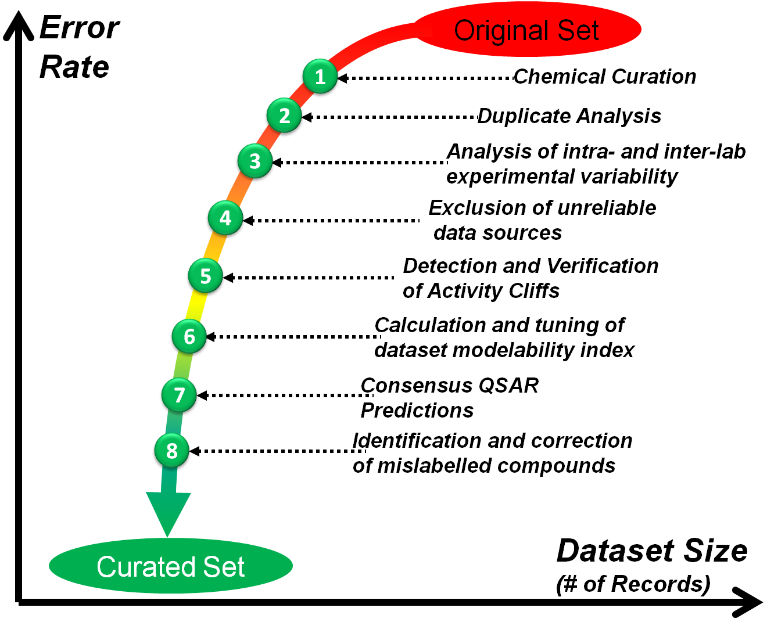
Biological data curation workflow
25
Fourches et al., Curation of Chemogenomics Data. Nature Chem. Bio., 2015, in press.

Slide 26
Case study: Small Molecule Antiviral Compound Collection (SMACC)
https://smacc.mml.unc.edu.
Martin, H. et al, Antiviral Res., 2023 Sep;217:105620.

Slide 27
Generalized Workflow
1. Database Generation
Identify all relevant assays on ChEMBL
Biological Curation
Chemical Curation
Ontological Harmonization
Activity Determination
2. Protein Conservation Analysis
Define Binding Site as 5Å from ligand
Analysis of Residue Conservation
Multiple Sequence Alignment
BLAST+ Search for all homologs
ID Viral Proteins with crystalized ligand in PDB
3. Compound Nomination
Summary of Available Assays and Project Goals
Compound Suitability
Compound Availability
Visual Inspection of Chemical Structure
Experimental Testing

Slide 28
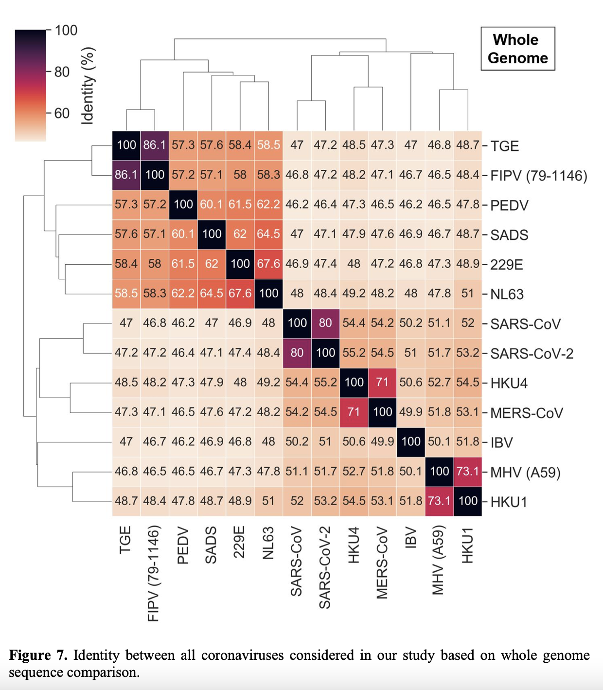
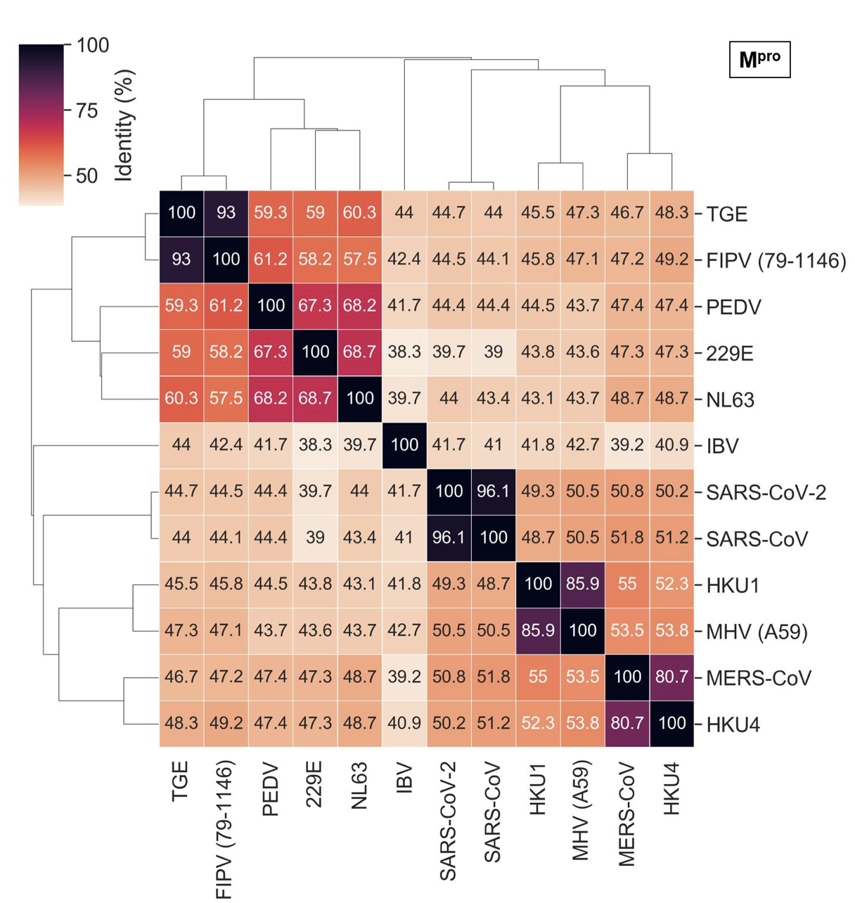
Coronavirus Conserved Proteins
Sequence identity between all coronaviruses considered in our study based on whole genome sequence comparison (left) and for Mpro only (right)

Slide 29
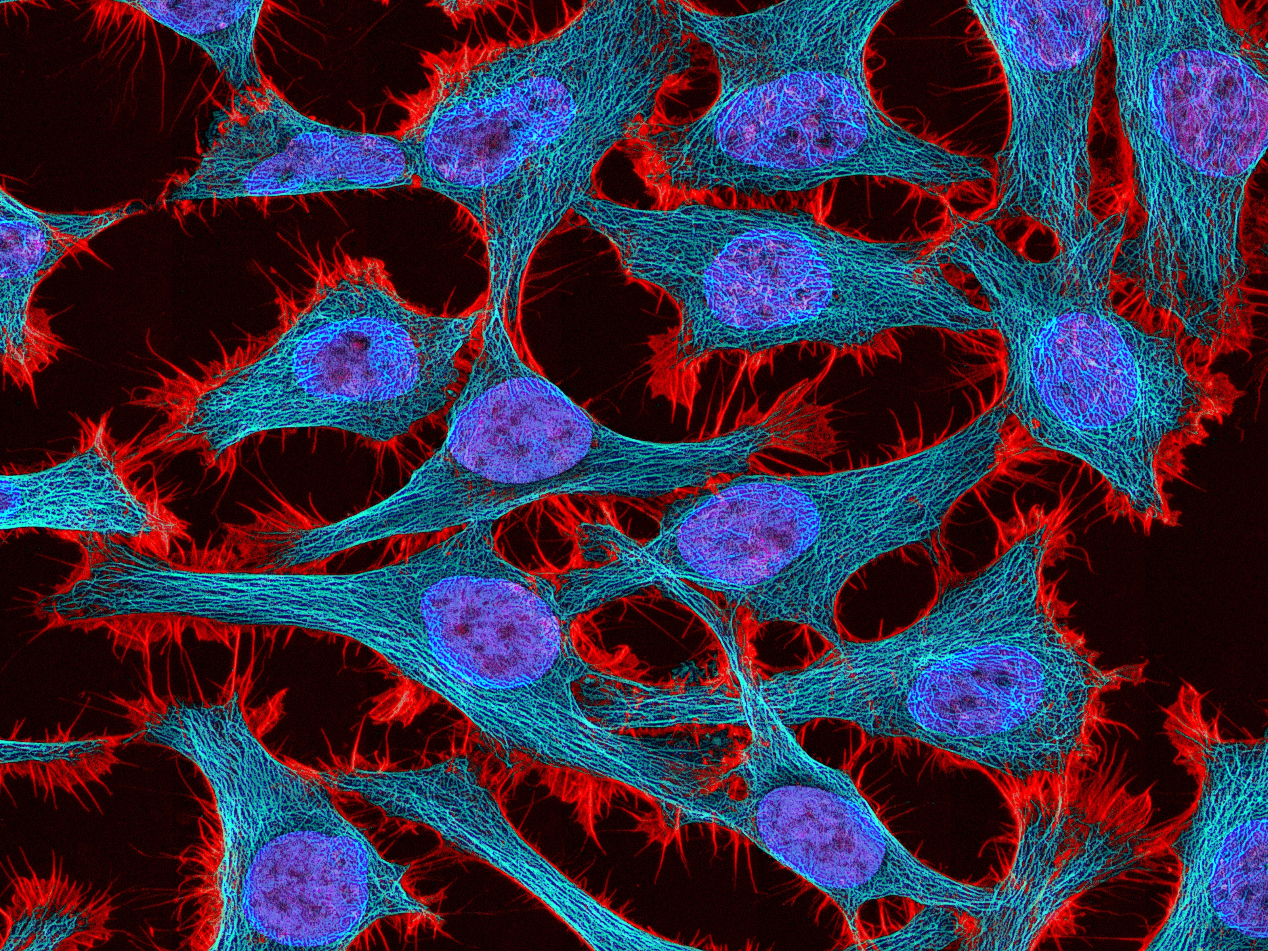
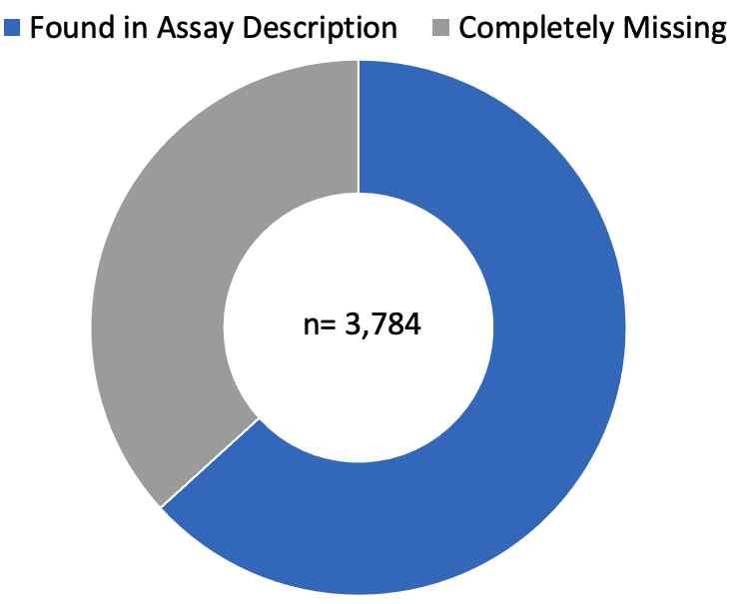
Heavy curation efforts: for instance, missing cell types in phenotypic assays
14% of all phenotypic assay results
were missing the cell-type from the designated field
Time spent: ~150 hours
Cell Type
36%
64%
Total time spent: ~200 Hours
Time spent: ~50 hours

Slide 30
BAO Mislabeling Impacts Data Accessibility
Using the “BAO Assay Type” as a filter to search ChEMBL for cell-based assay’s for my viruses of interest would have cost 99.44% of all collected data. It was effectively HIDDEN! “
… maybe assigning it via the target_type isn’t the best way to do it”
–ChEMBL Representative
BAO Labeling
Total time spent:
~25 Hours
Notes:
and because of this mislabeling We found that a lot of data was effectively hidden from our searches or later accidently filtered out
if one were to search for “cell-based assays” for our viruses of interest using the bioassay ontology assay type, 99.44% (27,410 of 27,562 entries) of the data would have been left out of the search.
And when we approached ChEMBL to clarify this discrepancy they informed us that part of their framework links the BAO assay label to the assigned TARGET TYPE in ChEMBL…
Which in my opinion is combining two separate pieces of information unesseccearily, especially because there being a separate column for defining target type..
and this is not something ChEMBL is talking about but they are fully aware of how hard it is to properly use these annotation frameworks like BAO
when Alex and I approached they told us that " maybe assigning by the target type isnt the best way to do it"
This issue highlights the need for careful data processing by the data curators so that users can obtain all of the existing but effectively, hidden data which they searched for.
Unfortunately, as it stands, one may need an advanced understanding of bioassay ontology (BAO) and ChEMBL’s structure required to extract all relevant datapoints.

Slide 31


Grave issues with ChEMBL’s antiviral assay ontology…
Assay Type
Assay Conditions
9 out of 13 viruses tested in a phenotypic assay was recorded in ChEMBL as being “Organism-Based” rather than “Cell-Based”. Despite no living organism, like a mouse, being present in the assay. Therefore, proper Bioassay ontology usage states that these assays should be reported as cell-based.
Total Time Spent Fixing These Issues: ~75 hours
Notes:
List reasons why each of these are such a big deal
i.e., outcome variability in assays across different cell types
BAO labeling… 9 out of 13 viruses tested in a phenotypic assay was recorded in ChEMBL as being “Organism-Based” rather than “Cell-Based”. Despite no living organism, like a mouse, being present in the assay. Therefore, proper Bioassay ontology usage states that these assays should be reported as cell-based.

Slide 32
Assay Ontology Issues: Assay Descriptions
Inclusions: virus, cell, assay, time, concentration, assessment, materials
Worst
Best
Antiviral activity determined as inhibition of SARS-CoV-2 induced cytotoxicity of VERO-6 cells at 10 uM after 48 hours exposure to 0.01 MOI SARS CoV-2 virus by high content imaging
Antiviral activity determined as inhibition of SARS-CoV-2 in HeLa cells
Antiviral activity against SARS-CoV-2
MOST COMMON
Virus Info Only
Virus + 1-2 Inclusions
All Inclusions

Slide 33

Another Challenge…
Compatible Assays?
Assay Integration
Total time spent: ~300 Hours

Slide 34


Major Realizations
Expectation
Reality
Antiviral assay data on ChEMBL is not “user-friendly”, as advertised
600+ hours of extra curation…(that’s roughly 4 months of 40-hour work week!)
Carefully search for and curate data!
Data reporting matters, A LOT!
Derivative database for antiviral assays was warranted
Youngling
Grand Master

Slide 35
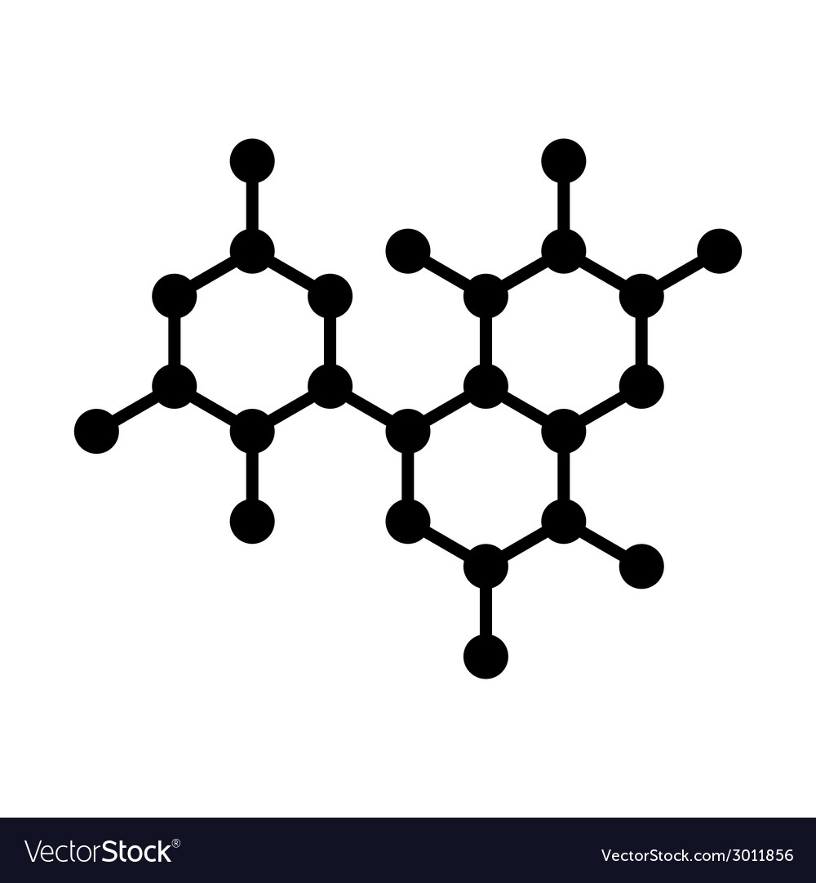
SMACC Data Composition
Small Molecule Antiviral Compound Collection (SMACC): a database to support the discovery of broad-spectrum antiviral drug molecules
Drug-Assay Pairs
Compounds
Assays
32,515
12,221
1,119
https://smacc.mml.unc.edu

Slide 36
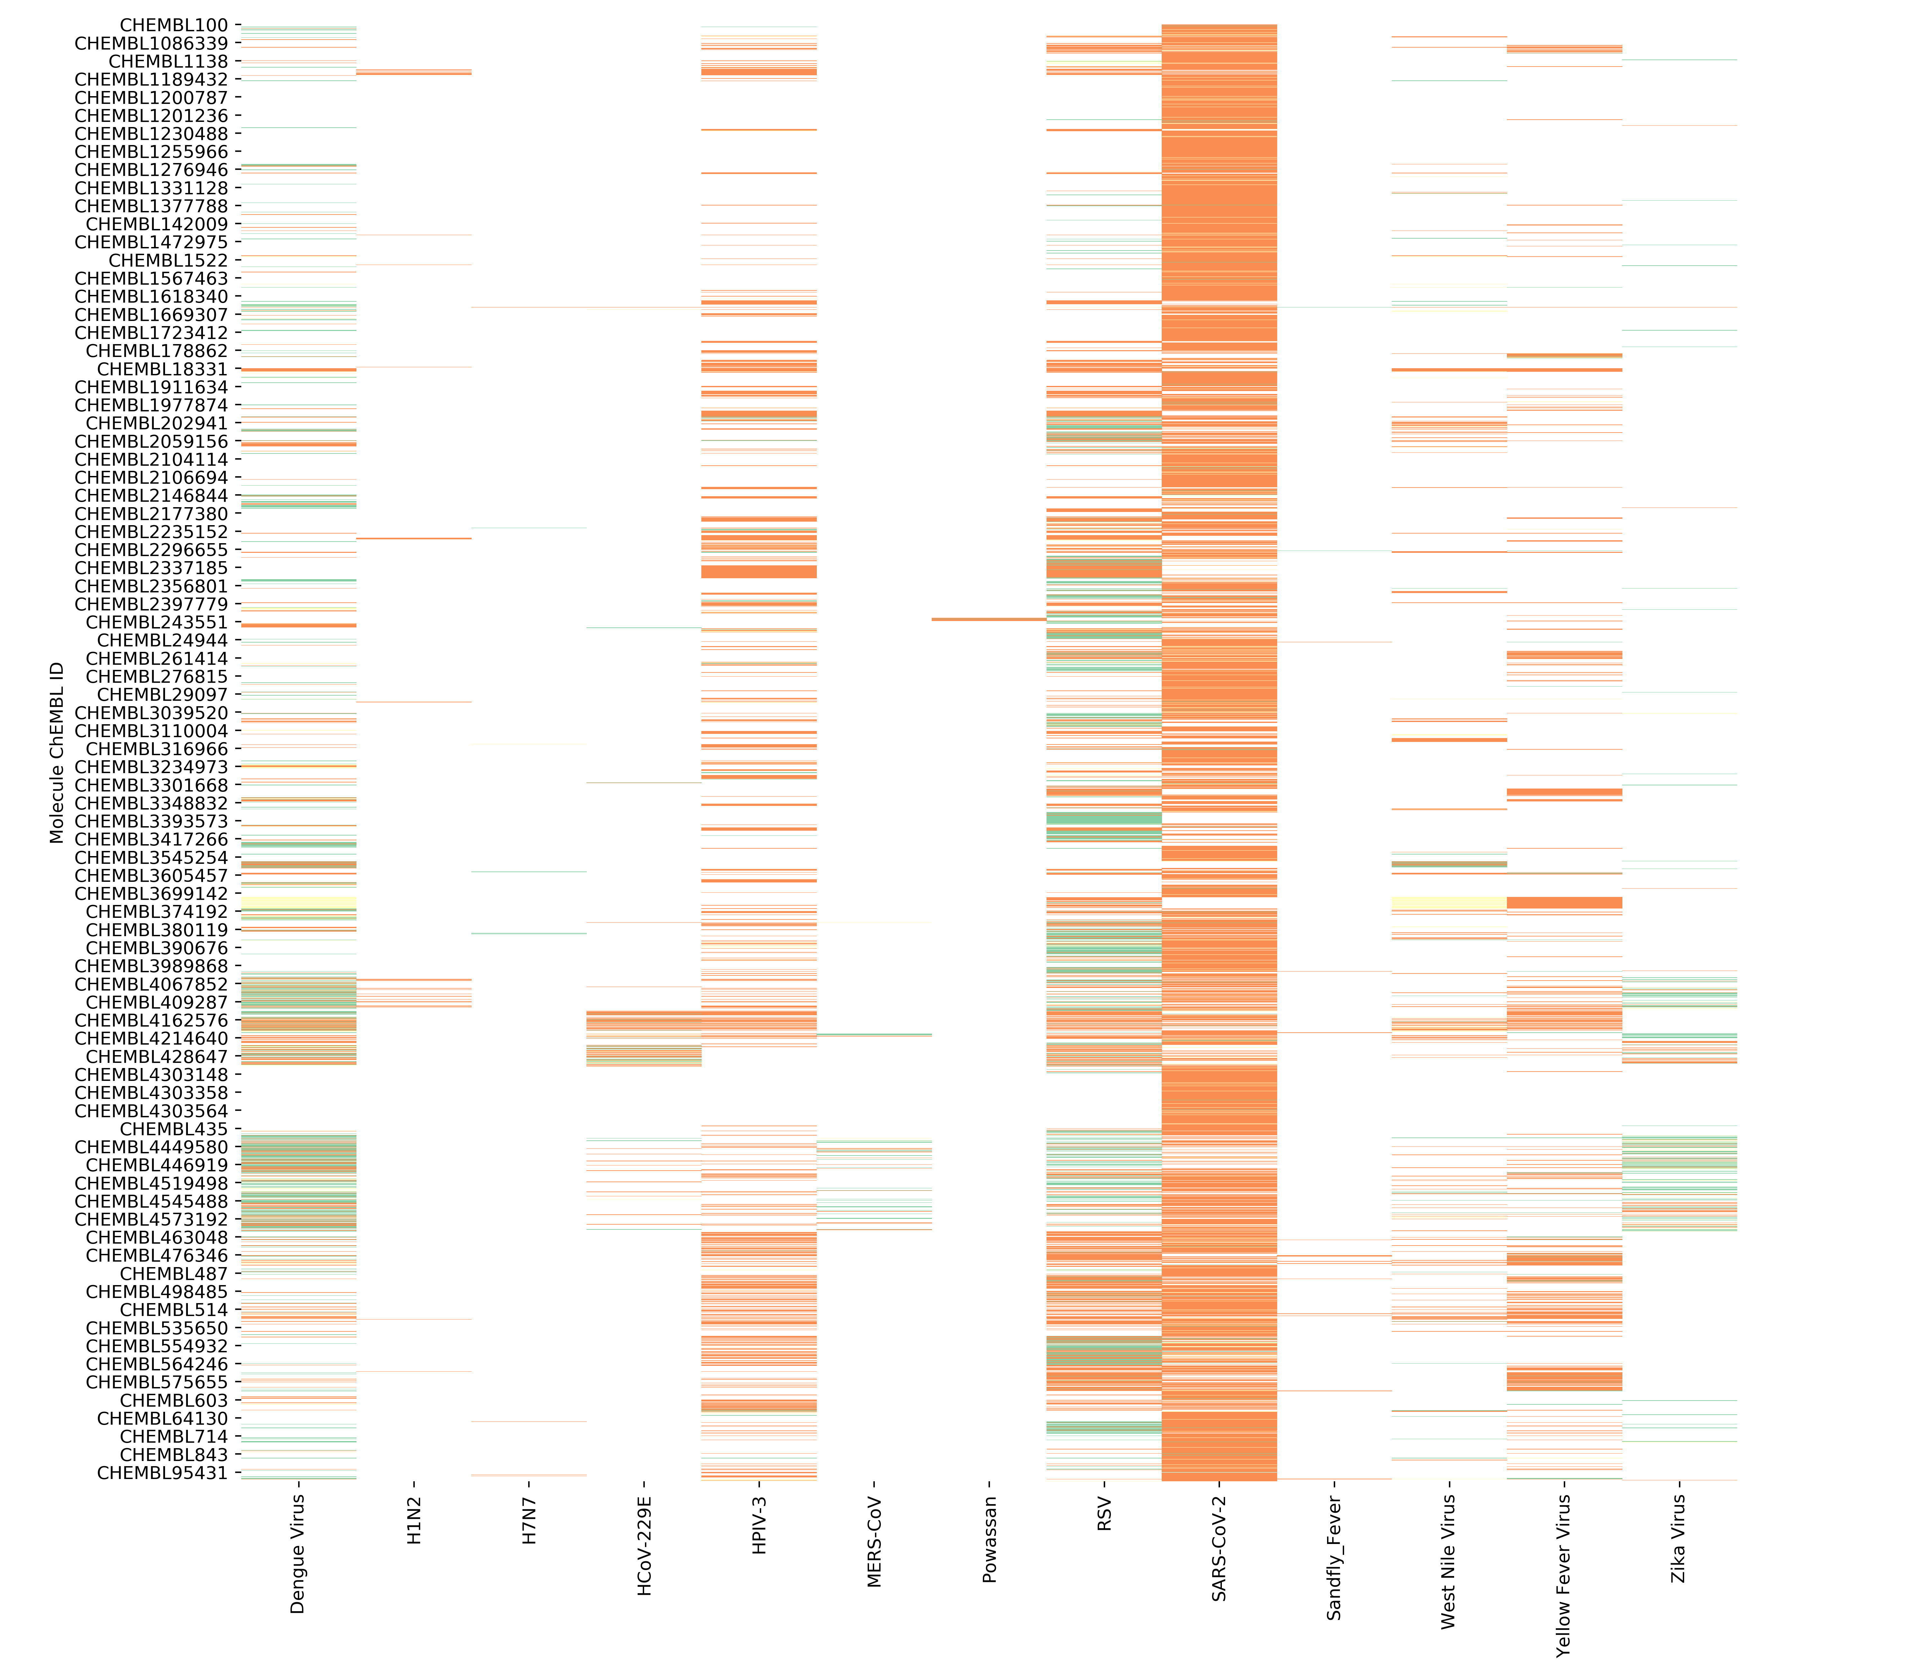
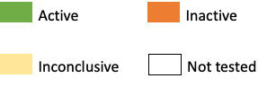
Compound Activity
32,515 compound entries x 13 viruses
Thresholds
% inhibition > 50
EC50 ≤ 10 µM
IC50 ≤ 10 µM
Molecule ChEMBL ID
Viruses

Slide 37
Process of Hit Selection
Introduction
Viruses
Targets
Compounds
Conclusions
Table summarizing bioactivities across all viruses in phenotypic and target-based assays
Preliminary Selection of Compounds with Desired Activity Profile
Analyze Compound Suitability
Molecular Properties
Assay Interference
Selectivity/Promiscuity
Compounds for Purchase/Synthesis
Notes:
Reiterate goal of hit selection

Slide 38


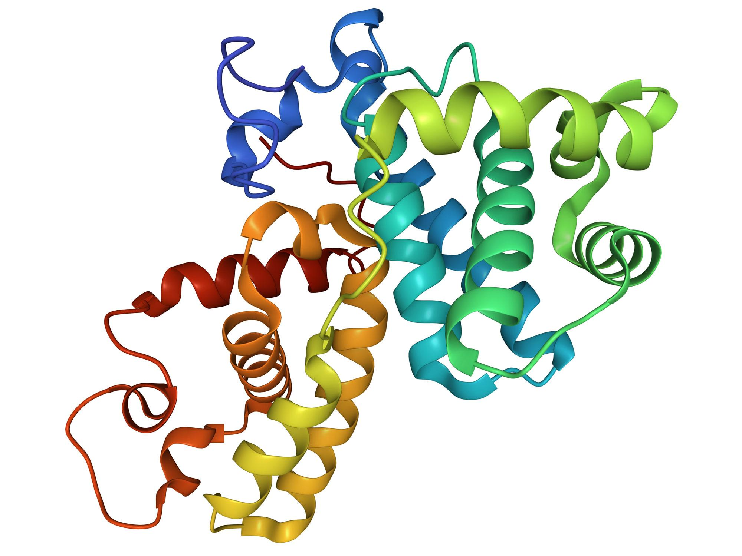
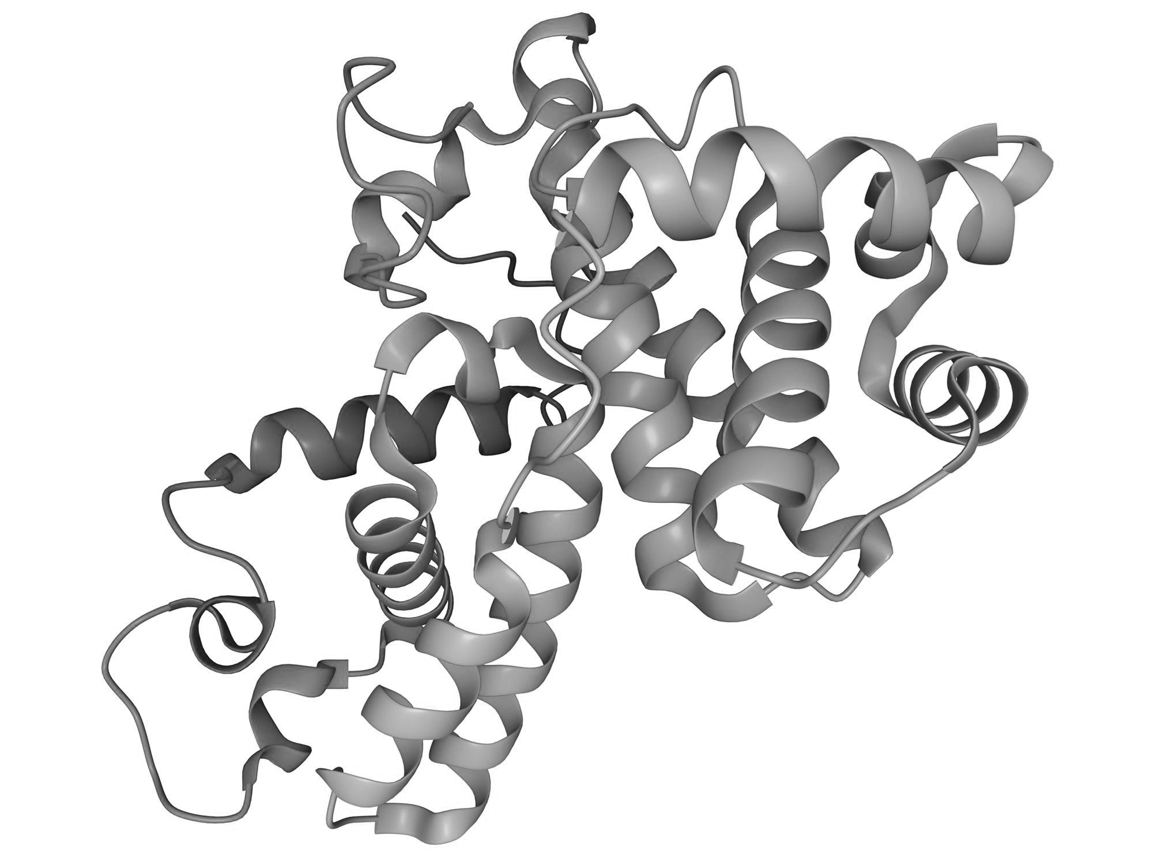
Compounds with Desired Activity Profile
Set the following criteria for selecting interesting compounds tested in 2+ assays
Active in 1+ phenotypic assay(s) in 2+ different viruses
Active in 1+ target-based assay(s) in 2+ different viruses
Active in 1+ target-based assay(s) in 2+ different viral proteins
Active in 1+ phenotypic assay(s) and 1+ target-based assay(s)
?
?
X
X
Untested in 1+ phenotypic assay(s) and active in 1+ target-based assay(s)
Active in 1+ phenotypic assay(s) and Untested in 1+ target-based assay(s)
Inactive in 1+ phenotypic assay(s) and active in 1+ target-based assay(s)
Active in 1+ phenotypic assay(s) and inactive in 1+ target-based assay(s)

Slide 39
Hypothesis-Driven Compound Selection
Criteria
Criteria
Criteria
X
Active in 1+ phenotypic assay(s) and 1+ target-based assay(s) (same virus)
Active in 1+ phenotypic assay(s) and inactive in 1+ target-based assay(s)
Active in 1+ phenotypic assay(s) in 2+ different viruses of same family
Hypothesis
Hypothesis
Hypothesis
Suggest Mechanism of Action
Acting at different protein
Broad-Spectrum for Viral Family
Recommendations:
1. Retest compound in SARS-CoV-1 and SARS-CoV-2

Slide 40
Testing Recommendations from Hypotheses
Criteria
Compound Profile Example
Compound ID | Phenotypic Activity | Phenotypic Inactivity | Untested Phenotypic | Untested Target-Based
Compound X | Dengue 1; Zika | None | Yellow Fever; West Nile; Dengue 2-4 | All
Active in 1+ phenotypic assay(s) in 2+ different viruses
Hypothesis
Testing Recommendations
Broad-Spectrum for Viral Family
Retest this compound against Dengue 1 and Zika to ensure assay compatibility
Test against Dengue 2-4, West Nile, and Yellow Fever due to high conservation amongst flavivirus proteins
Recommendations:
1. Retest compound in SARS-CoV-1 and SARS-CoV-2

Slide 41
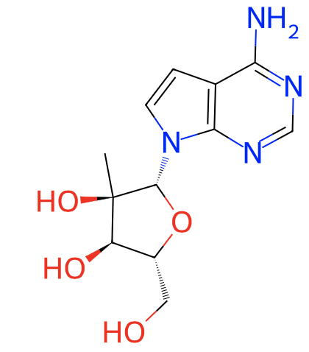
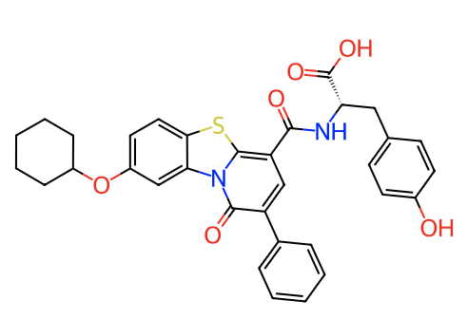
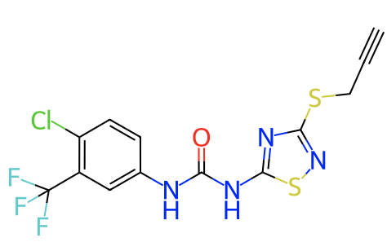
SMACC Compounds Tested in Flaviviruses
Virus | CHEMBL4212750 | CHEMBL236207 | CHEMBL4526128
Dengue 2
Dengue 3
Dengue 4
Zika
West Nile
Zika
Reported Activity
New Experimental Activity
Notes:
Tested where? What level of activity? How these compounds are selected…..I need a storyline!
With an interest in the flaviviruses, we followed the compound nomination workflow from slide 2 to select these compounds (amongst ~70 others) from SMACC.
These compounds were tested in the AViDD program at 10uM and 1uM against DENV2 and DENV4 nLuc viruses in Huh7 cells.
Each of these compounds showed DENV 2 & 4 activity <10 uM (some also <1 uM)
I specifically selected these compounds to put on the slide to exemplify the hypothesis we had about the flaviviurses conservation: there is a high conservation across proteins within the flavivirus family. Where you can see that each of these compounds had reported activity against other flaviviruses in ChEMBL (<10 uM inhibition (IC50, etc.) and we found that they are also active in DENV 2/4.

Slide 42
Notes on the importance of data curation
The curation of chemical data is critical prior to any cheminformatics analysis and modeling. Difficult cases require human interventions and cannot be fully automated.
Prediction outliers may be due to structural outliers, real activity cliffs or mislabeled compounds. Many of them can still be detected and removed prior to modeling studies boosting the reliability of QSAR model.
Rigorously developed QSAR models can be used to correct erroneous biological data associated with certain compounds.
42

